Slide 1
M Tech Project Phase-1
ESA
Student Name : CHORAGUDI PRAVEEN
SRN : PES1201802271
Data Quality enhancement and monitoring framework for High Performance Computing Systems leveraging machine learning techniques.
Project Title :
Project Guide : Prof. Suresh Jamadagni

Slide 2
Problem Statement
HPC Business is unable to obtain actionable indicators due to diverse data sources that are not integrated and data is not of right quality.
The data that is originating from the source systems is not standardized, integrated, deduplicated and cleansed.
Information flows in from over 150+ projects into a central repository.
The key master data entities across the sources aren’t standardized, leads to ineffective/non-actionable business indicators.
Information from various sources needs to flow into a centralized DataMart in a summarized fashion. Information lacks traceability, hence, data is less actionable.

Slide 3
Project Abstract and Scope
HPC Business is unable to obtain actionable indicators due to diverse data sources that are not integrated and data is not of the right quality. The data that is originating from the source systems is not standardized, integrated, deduplicated and cleansed leading to ineffective/non-actionable business indicators.
So, we aggregate the data to identify the common master data sets; source the “clean” dataset and feed it to the learning engine and apply the generated model to auto-cleanse, suggest or run human-assisted/semi-automated scenarios.
By doing this, we want to achieve significant reduction in data quality deviations with on-the-fly fixing of about 70% of the master data entities, as identified by Data Quality indicators and dynamic recommendations to fix about 20% of the persistent data sets.

Slide 4
Literature Survey
Paper | Concluding Thoughts
Data Lifecycle: From Big Data to Smart Data - an IEEE paper by M. EL ARASS & N. SOUISSI 2018 | The authors have implemented at very abstract level, but I’m looking from the granular level of voluminous data with different approach achieving traceability.
Big Data Quality Assessment Model for Unstructured Data an IEEE paper by Ikbal Taleb, Mohamed Adel Serhani and Rachida Dssouli 2018 | The type of data dealt is different in the case of this project; but would consider some key aspects discussed in this paper and use them if feasible.
Kafka: A Distributed Messaging System for Log Processing - an ACM journal by Jay Kreps, Neha Narkhede, Jun Rao | This is very much useful as we have implemented this for ingesting job history files and found very reliable.
Data Security and Quality Evaluation Framework: Implementation Empirical Study on Android Devices- by Igor Khokhlov, Leon Reznik, Ashish Kumar, Ankan Mookerjee, Rohan Dalvi | Since we are also dealing with voluminous data security and data quality needs to be addressed. Henceforth, this case study helped me to try similar kind of techniques for our data.

Slide 5
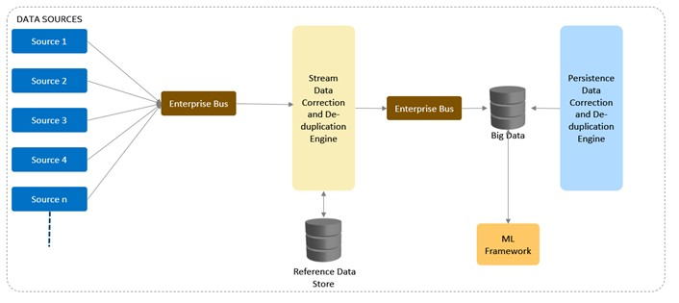
Proposed Solution
There are two mitigation points :
One engine that corrects the information on the fly. This engine will be designed to fix less-data-intensive checks.
The second engine fixes much more regressive issues, that require data-intensive-operations.
Both the system will leverage Machine learning, big data framework, data de-duplication and other data quality techniques to ensure that data meets business expectations.

Slide 6
Proposed Solution (contd..)
Aggregate the data from across dozens of systems to identify the common master data sets.
Source the “clean” dataset, feed it to the learning engine.
Apply the generated model to auto-cleanse, suggest or run human-assisted/semi-automated scenarios.
Broaden the sample data as the learning progresses.

Slide 7
Design Approach
The Extreme Programming software development approach is adopted as the proposed solution is research and exploratory in nature.
Benefits:
Rather than planning, analyzing, and designing in a linear fashion, we can do all such activities a little at a time throughout the development phase.
Putting a minimal working system which in our case is to extract data from disparate sources to connect data sets to achieve meaningful 360 degrees perspective of data in a continuous manner.
Facilitating iteration of the accommodating changes as the software evolves with the changing requirements when ingesting data from multiple sources to build a Machine Learning model further.
Drawbacks:
There are no drawbacks so far by following this approach.
Alternate Design approach:
Dynamic Systems Development Methodology can be an alternative, but this can lead to decrease in code robustness as it focus on RAD primarily.

Slide 8
Design Constraints, Assumptions & Dependencies
Constraints:
As the data is flowing in from disparate systems, it should be parsed and stored in the database. The risk involved here is to be able to parse voluminous data avoiding memory related errors.
For the real time data processing, data loss is expected. So, it has to be taken care by proper cluster management or by deploying adequate consumer groups or by creating multiple topics in apache kafka.
Dependencies:
In order to proper functioning of the system, it is essential that the data sources shall not be down which leads to inactivity or a halt in the data ingestion pipeline.

Slide 9
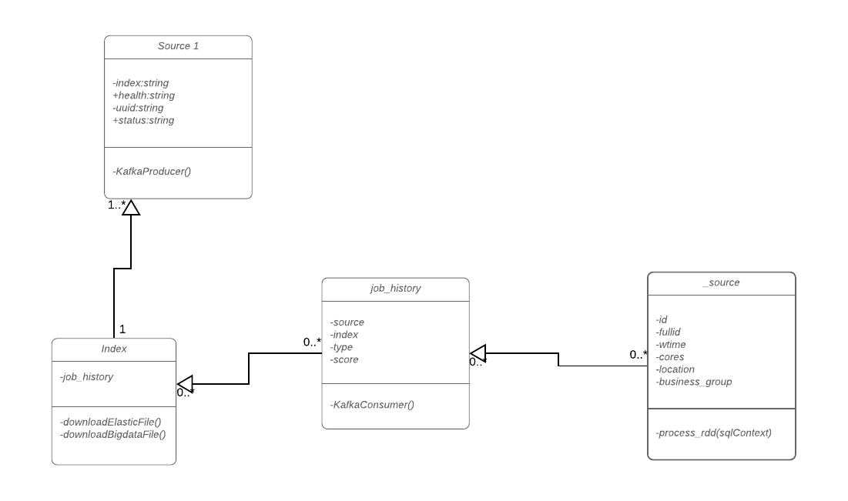
Class Diagram
Note: Master Class Diagram will be shown post complete sourcing of data. The diagram shown above is of the sample data.

Slide 10
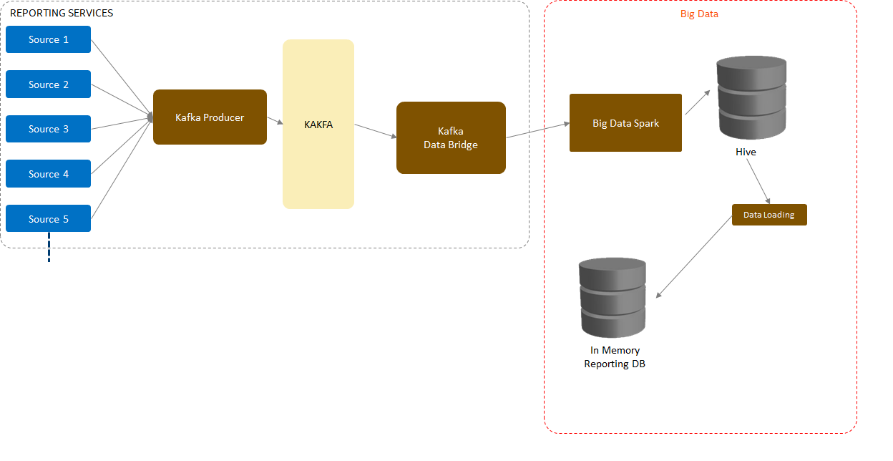
Data Ingestion Pipeline
This is the end-to-end data ingestion pipeline which is done completely and now we have data to determine or choose which ML model to use in order to achieve prediction.

Slide 11
Data Processing information
Volume of the incoming data from source system as of today
Number of files | 2875
Size of data processed | 290 GB
Velocity of the incoming data from source system in a day
number of files | 115 (with average size of 100 MB)
number of records | 80,500
Note: The above status are from sample source of data from one of the disparate system only.

Slide 12
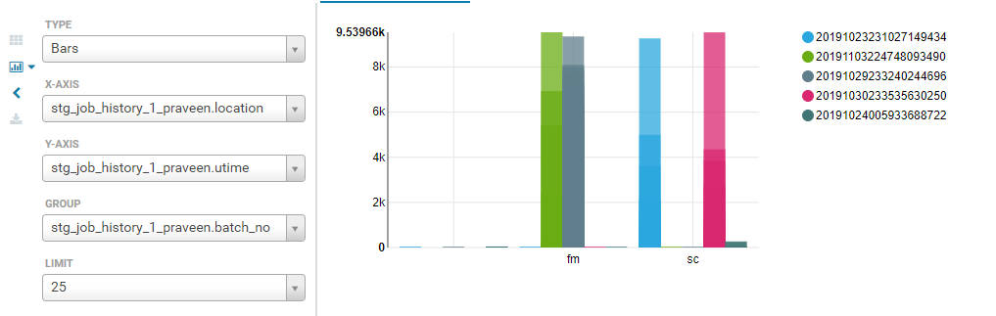
Analytical Results post Data Pre-processing
Above Bar Graph with Location data on X axis and uptime on Y axis based on the batch number

Slide 13
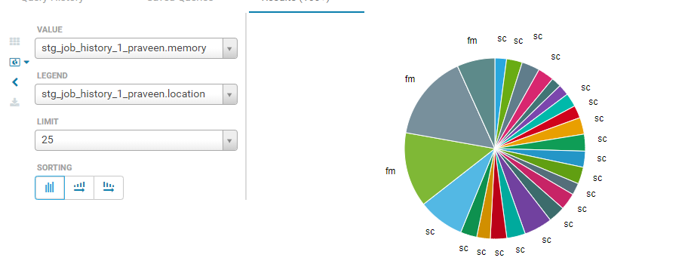
Analytical Results (contd..)
Above Pie diagram shows the memory utilisation by location.

Slide 14
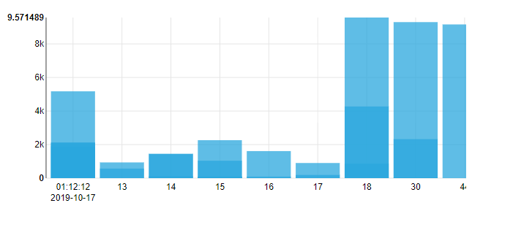
Analytical Results (contd..)
Above bar graph shows job finished time versus waiting time batch wise.

Slide 15
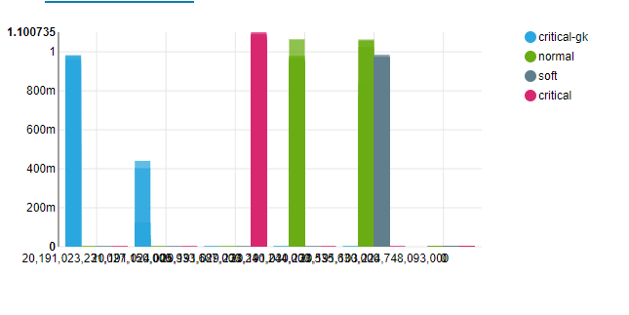
Analytical Results (contd..)
Above bar graph shows efficiency batch wise.

Slide 16
Project Progress So far
✔️Analysis & Analytics Phase:
Sourcing sample data from top source.
Analyze static and dynamic data sets.
Identify data entities/ attributes for standardization.
Defining the standardization mechanism.

Slide 17
Technologies Used
Python, NumPy - for data analysis
Big Data technologies: Spark, Spark Streaming, HDFS, Hive, Pig, Scala (tentative), Beehive etc
- for data extraction and performing various operations on streaming and persistent data.
Middleware: Apache Kafka - for real time data processing with distribution, performance and reliability, REST API - for communication with other modules.
Spark MLlib - to make practical machine learning scalable and easy using it’s built in tools such as ML Algorithms, Featurization, Pipelines, persistence and utilities.

Slide 18
Project Demo

Slide 19
Future Work to be carried for Phase-II
Machine Learning, Data Quality and Integration:
Identifying the machine learning techniques that can be leveraged.
Sourcing complete data.
Apply Machine Learning techniques on entire data set, validate effectiveness.
Create the API, integrate it with the data ingestion framework.
Solution Delivery:
Streamlining the solution and deliver it to production.

Slide 20
Future Work to be carried for Phase-II (contd..)
Out of 150+ data sources, expected to have at least a 100 relatively-static/master data entities
As project is in a early explore phase, team does not have enough information to predict which model would apply to which of the entities. Here is what we presume it needs to be :
Classification Model
Org Hierarchy Data, Location Data
Clustering Model
TBD
Forecast Model
For capacity planning and demand management
Outlier Model
For error data classification
Time Series Model
Utilization

Slide 21
Thank You

